Slide 1
The Impact of Technology on Society
Created and Presented
By
Huzaifa Iqbal

Slide 2
Topics we are going to discuss:
Introduction
Communication
Workplace
Education
Implications
Conclusion

Slide 3
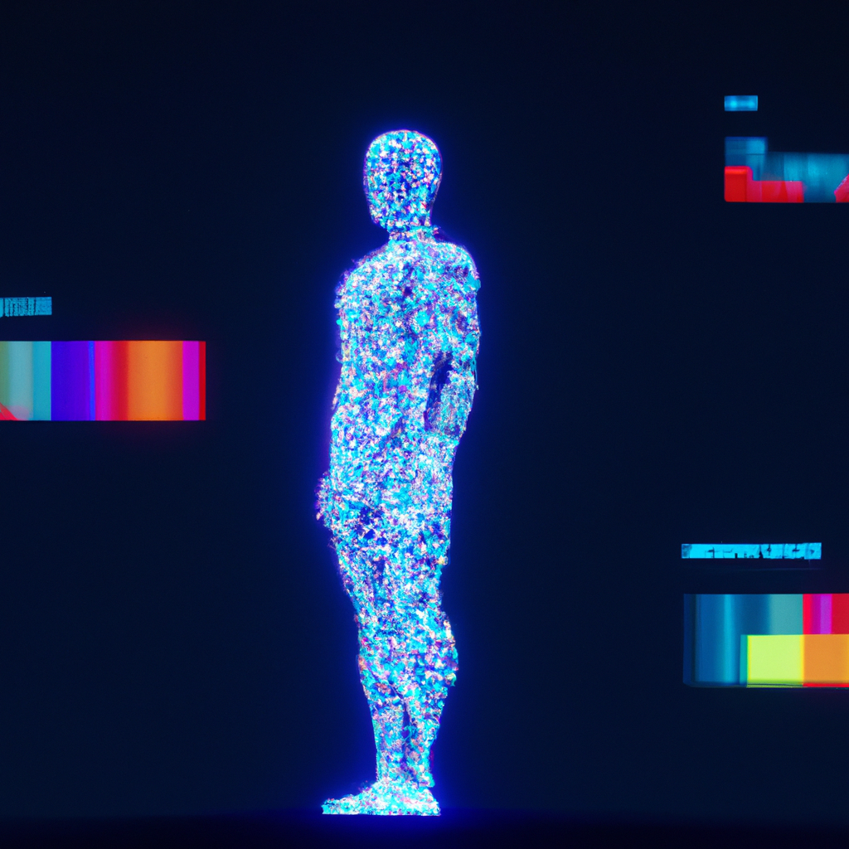
INTRODUCTION
Technology has had a profound impact on society. It has changed the way we communicate, work, and even the way we think. This presentation will explore the impact of technology on society and its implications for the future.
The effects of technology can be seen in many aspects of life, from business to education and beyond. We will examine how technology has changed the way we interact with each other, how it has impacted the workplace, and how it has shaped our lives.

Slide 4

COMMUNICATION
Technology has had a major impact on communication. Social media platforms have allowed people to connect with each other in ways that were never before possible. We can now communicate with people from all over the world in just a few seconds.
Moreover, technology has enabled us to communicate in ways that were not possible before. We can now send text messages, make video calls, and even share photos and videos with people from anywhere in the world.

Slide 5

WORKPLACE
Technology played major impact on the workplace. Automation has allowed companies to increase efficiency and reduce costs. Moreover, technology has enabled companies to communicate more effectively with their employees and customers.
Additionally, technology has enabled companies to create virtual work environments and access a global talent pool. This has allowed companies to expand their reach and increase their productivity and profitability.

Slide 6

EDUCATION
Technology has had a major impact on education. It has enabled students to access information faster and more easily. Technology has also enabled students to collaborate and learn from each other in ways that were not possible before.
Moreover, Modern technology has allowed students to interactive with new learning opportunities. Technology has also enabled schools to create virtual classrooms and access a global pool of students.

Slide 7
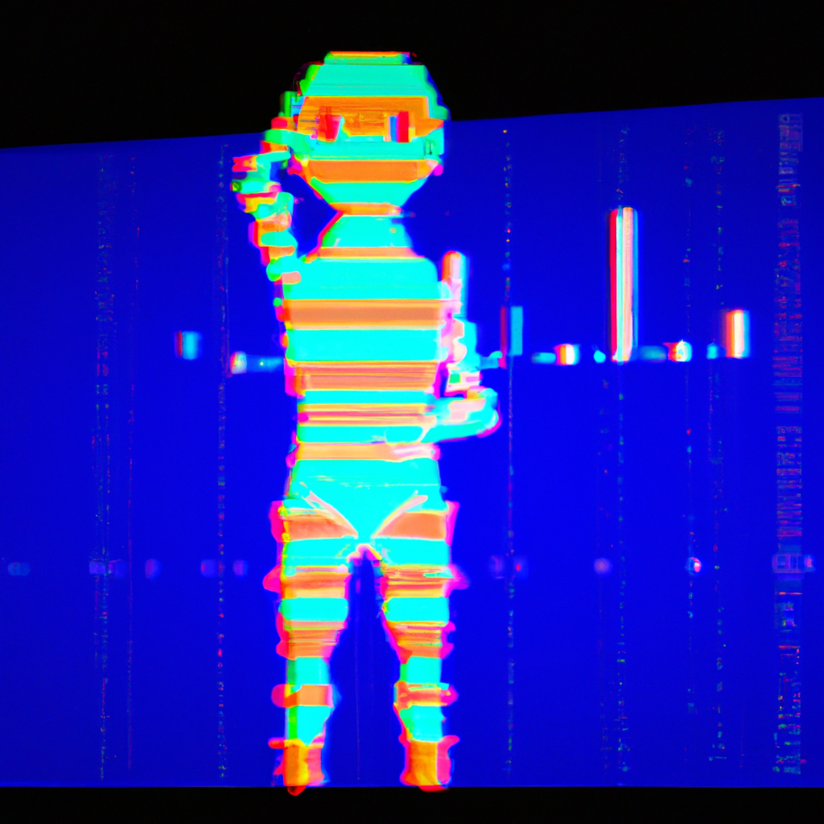
IMPLICATIONS
The implications of technology on society are far reaching. Technology has enabled us to connect with each other in ways that were not possible before. It has also enabled us to communicate more effectively and to increase productivity in the workplace.
Moreover, technology has enabled us to access information faster and more easily. It has also enabled us to create interactive and engaging learning experiences for students. These implications will continue to shape our lives for years to come.

Slide 8

CONCLUSION
Technology has had a profound impact on society. It has changed the way we communicate, work, and even the way we think. Technology has enabled us to connect with each other in ways that were not possible before and to access information faster and more easily.
The implications of technology on society will continue to shape our lives for years to come. It is important to consider the implications of technology and to understand how it can be used to improve our lives.

Slide 9
THANK YOU!!!

